Slide 1
Planet image purchase approval?
QA on timing validation and timing estimate data to create timing validation map
Mask out timing validation data if it was a ‘guess’ (i.e. no Planet images for 2 months; reported data doesn’t match with EVI timeseries)
Mask out estimated timing if quarter period was not between 15 and 60; and if peaks were not between 1 and 300 days after Aug 1
Sources of error and bias
If there’s a sizeable (i.e. a month) bare soil gap between first and second crop, it’s easier to see p2 and h1; if they come very close together in time, they’re hard to separate in the MODIS timeseries (there’s just a gap of no data between h1 and p2), and it’s easy to get estimates wrong (and therefore will be masked out – source of bias?)
When there’s a short cycle ‘starter crop’ before the first crop, both the estimates and validation data get confused. This isn’t necessarily masked out in the estimates, because the resulting estimates might still be reasonable.

Slide 2
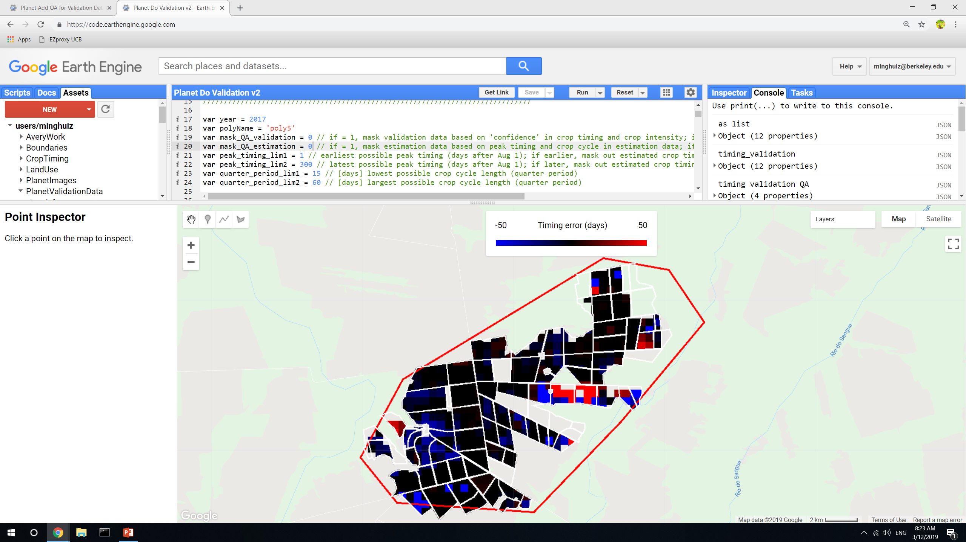
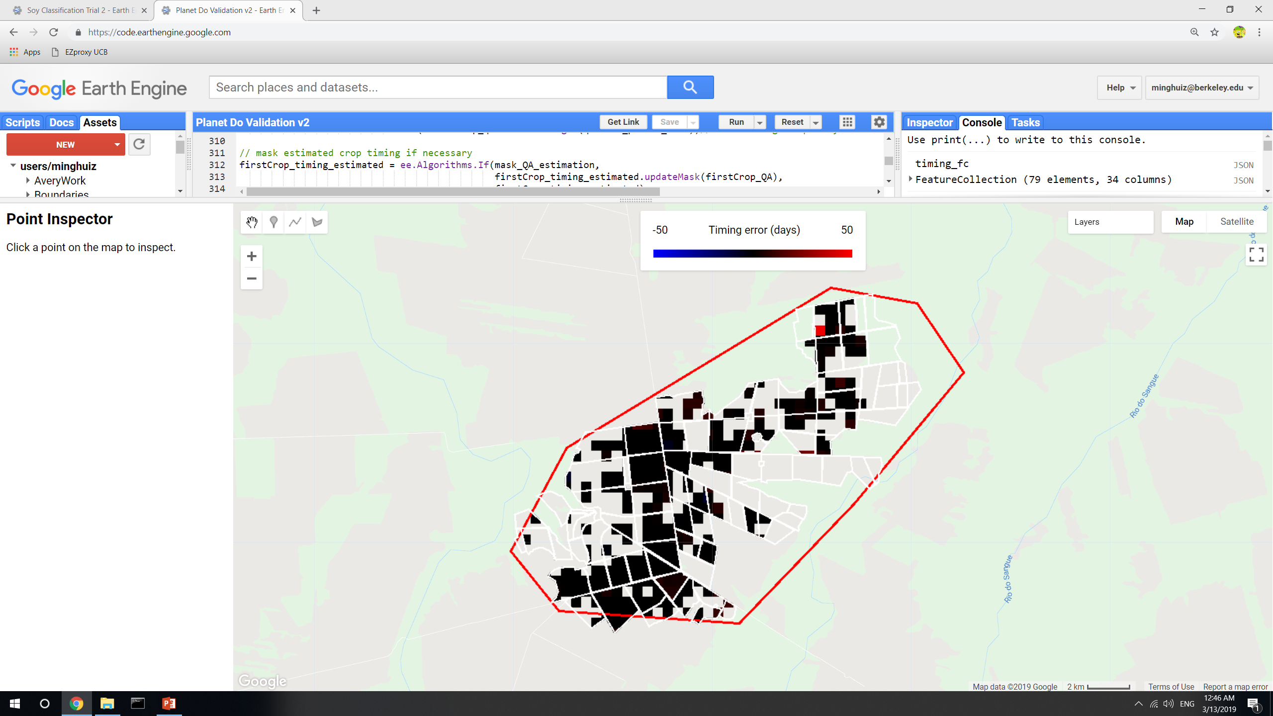
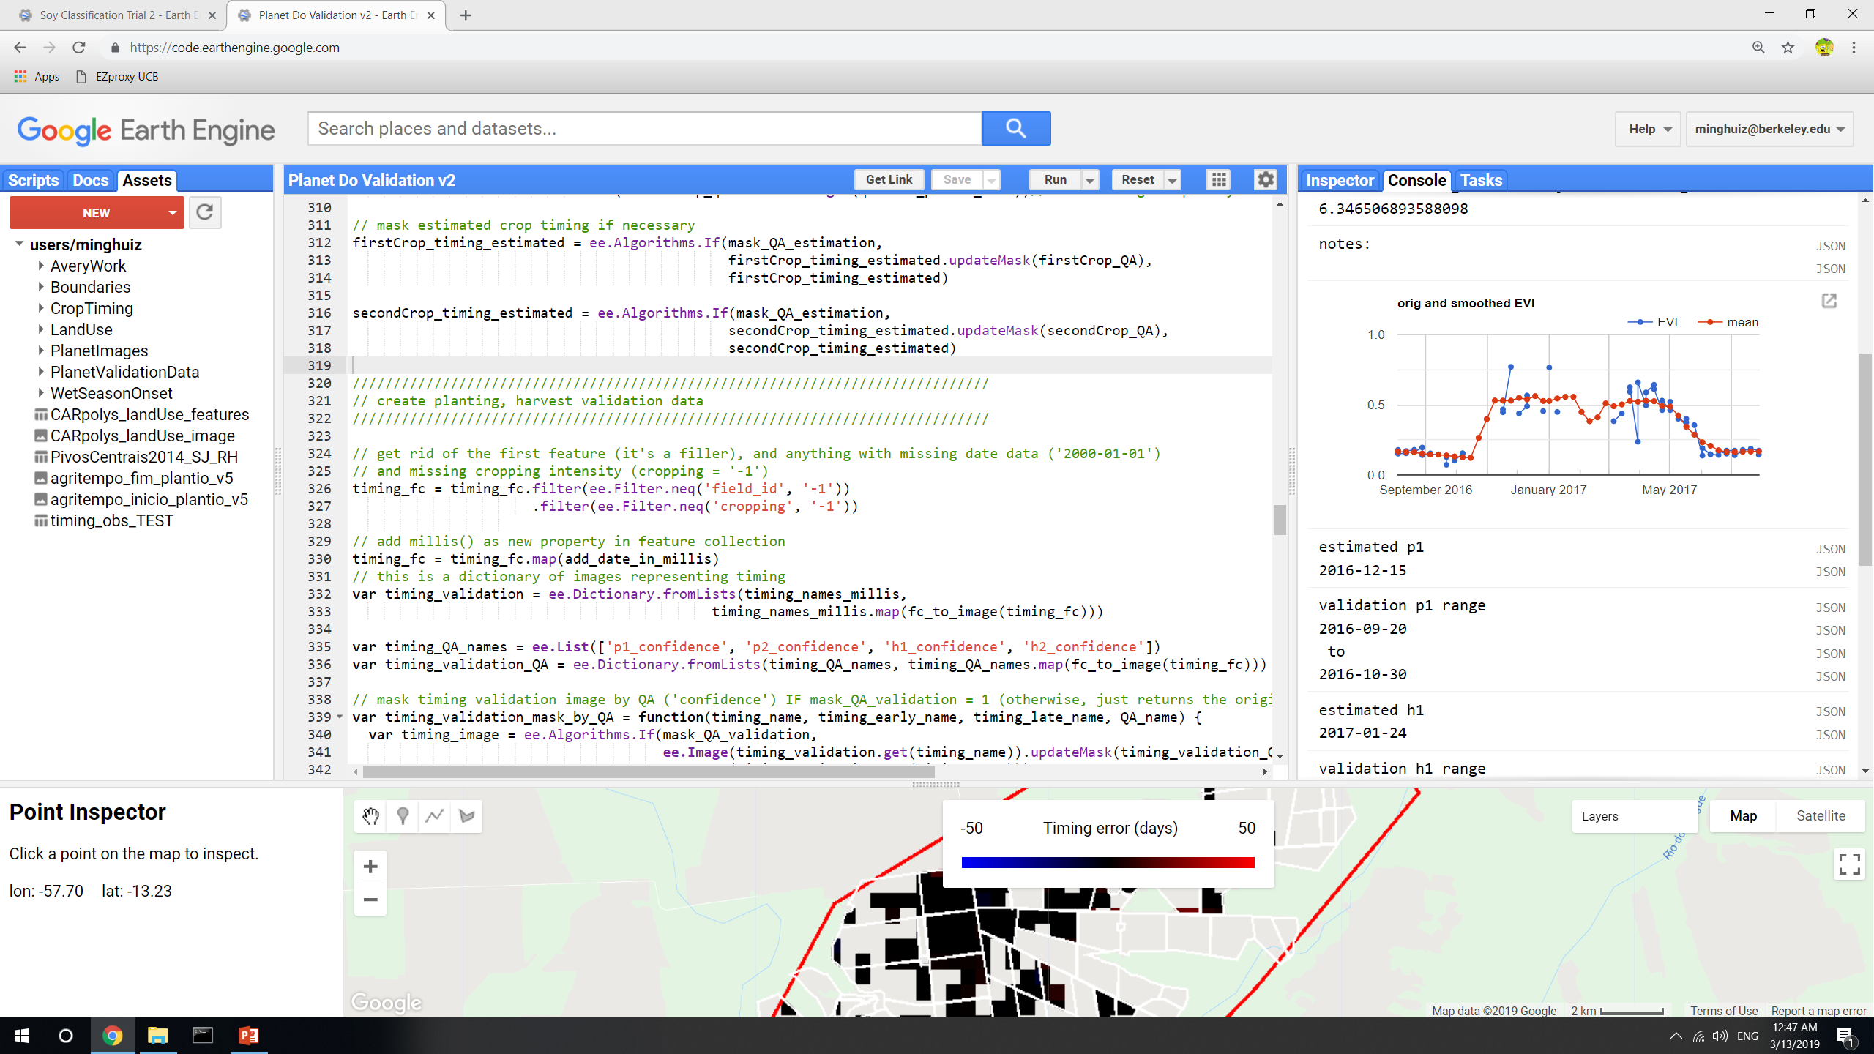
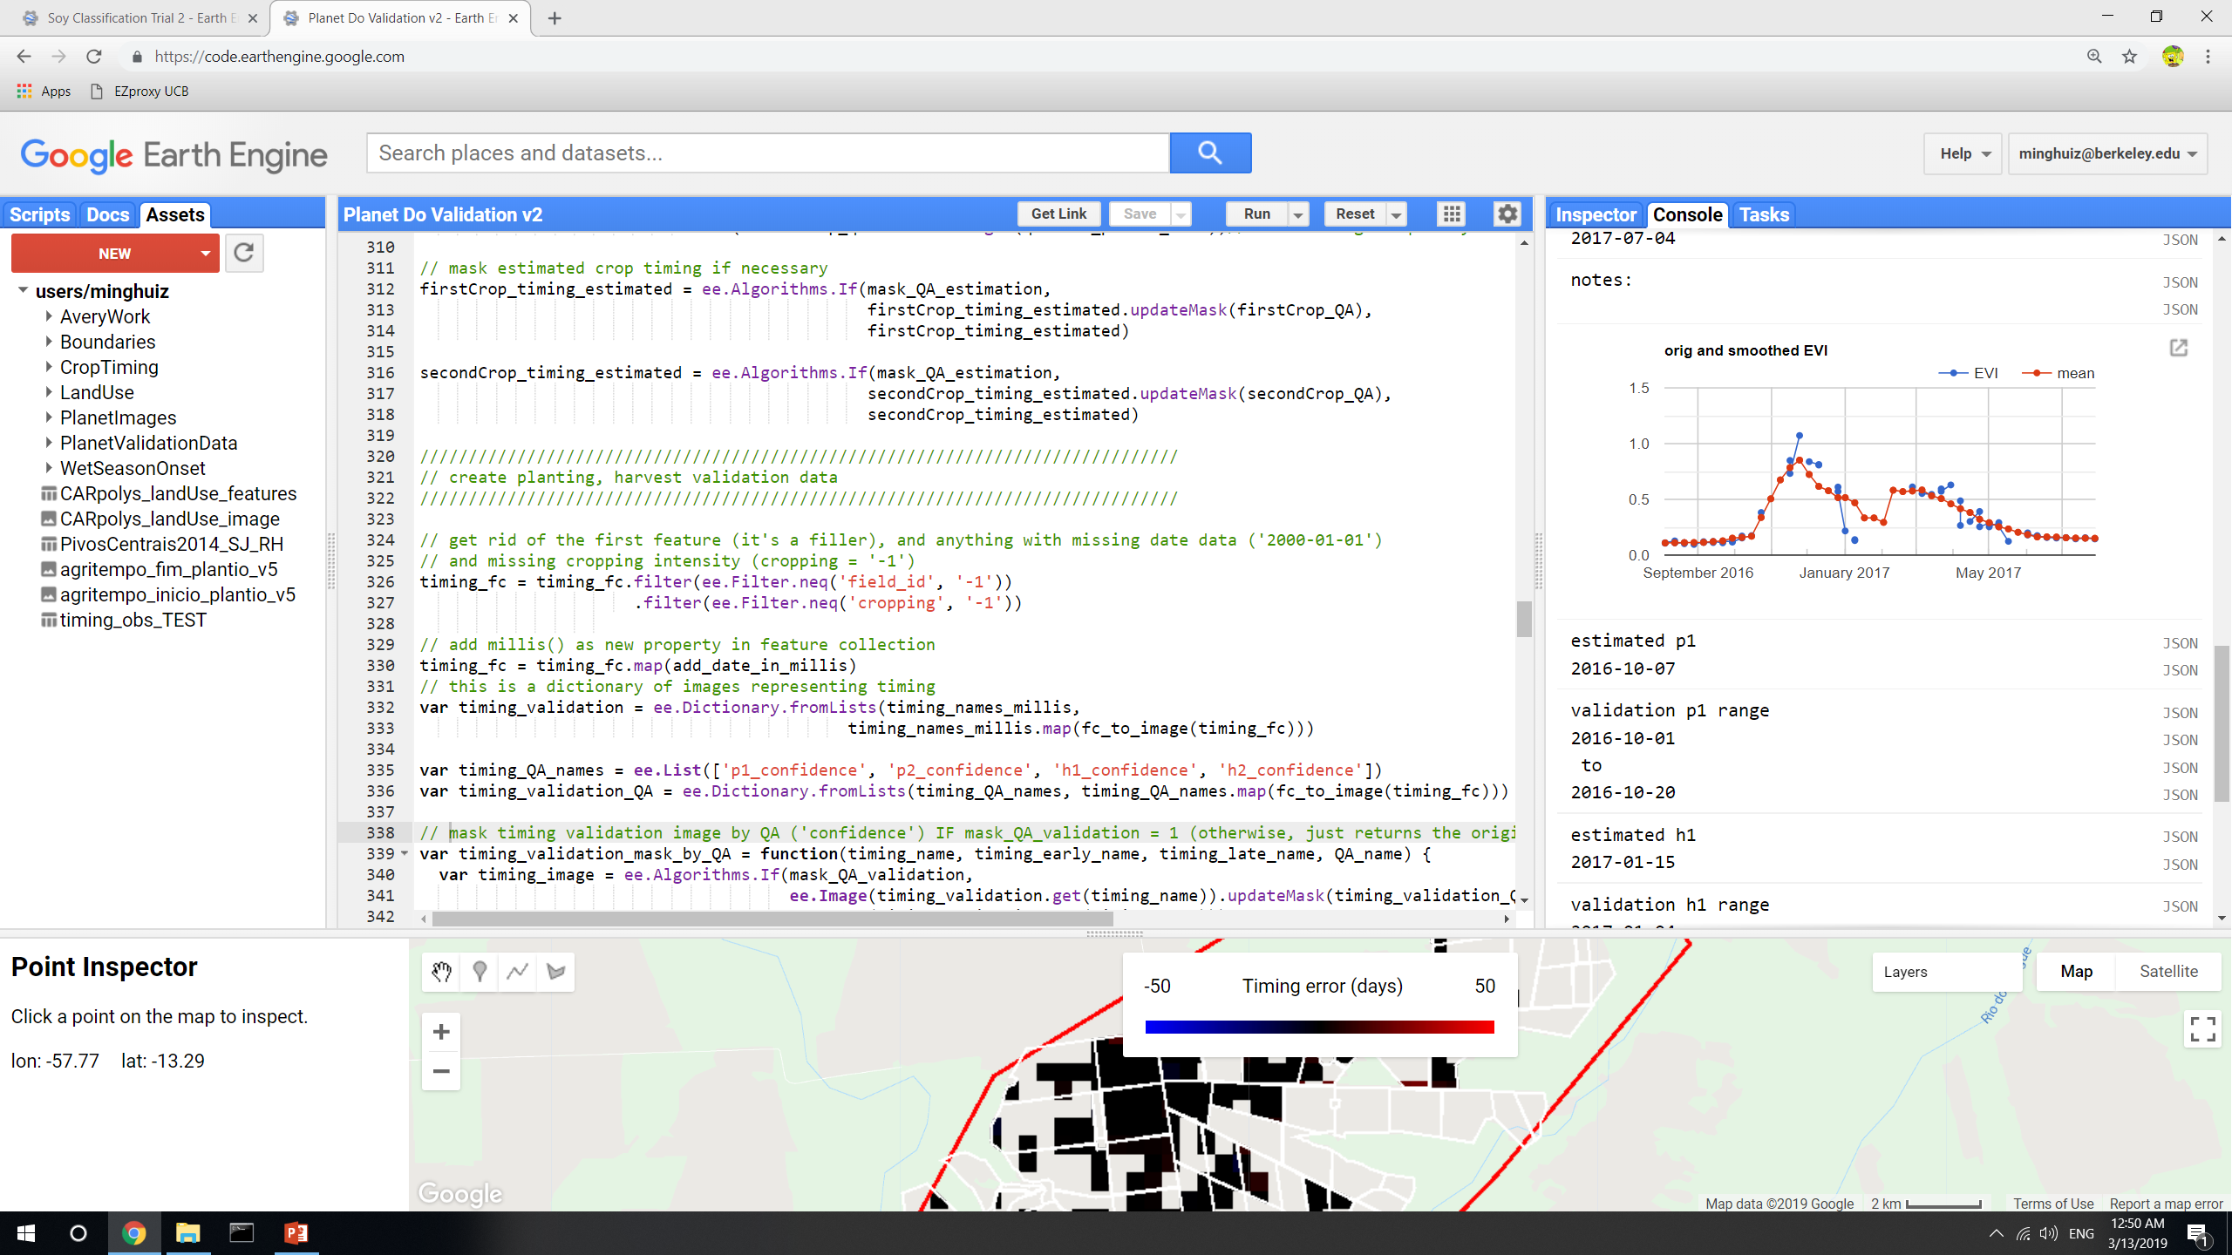
Poly5, 2017 before QA masking
Poly5, 2017, plant 1 after QA masking (of both pixel level estimates and entire fields based on validation data confidence)
Unsure why estimated planting was totally off
GEE file: LandCover/Planet Do Validation v2

Slide 3
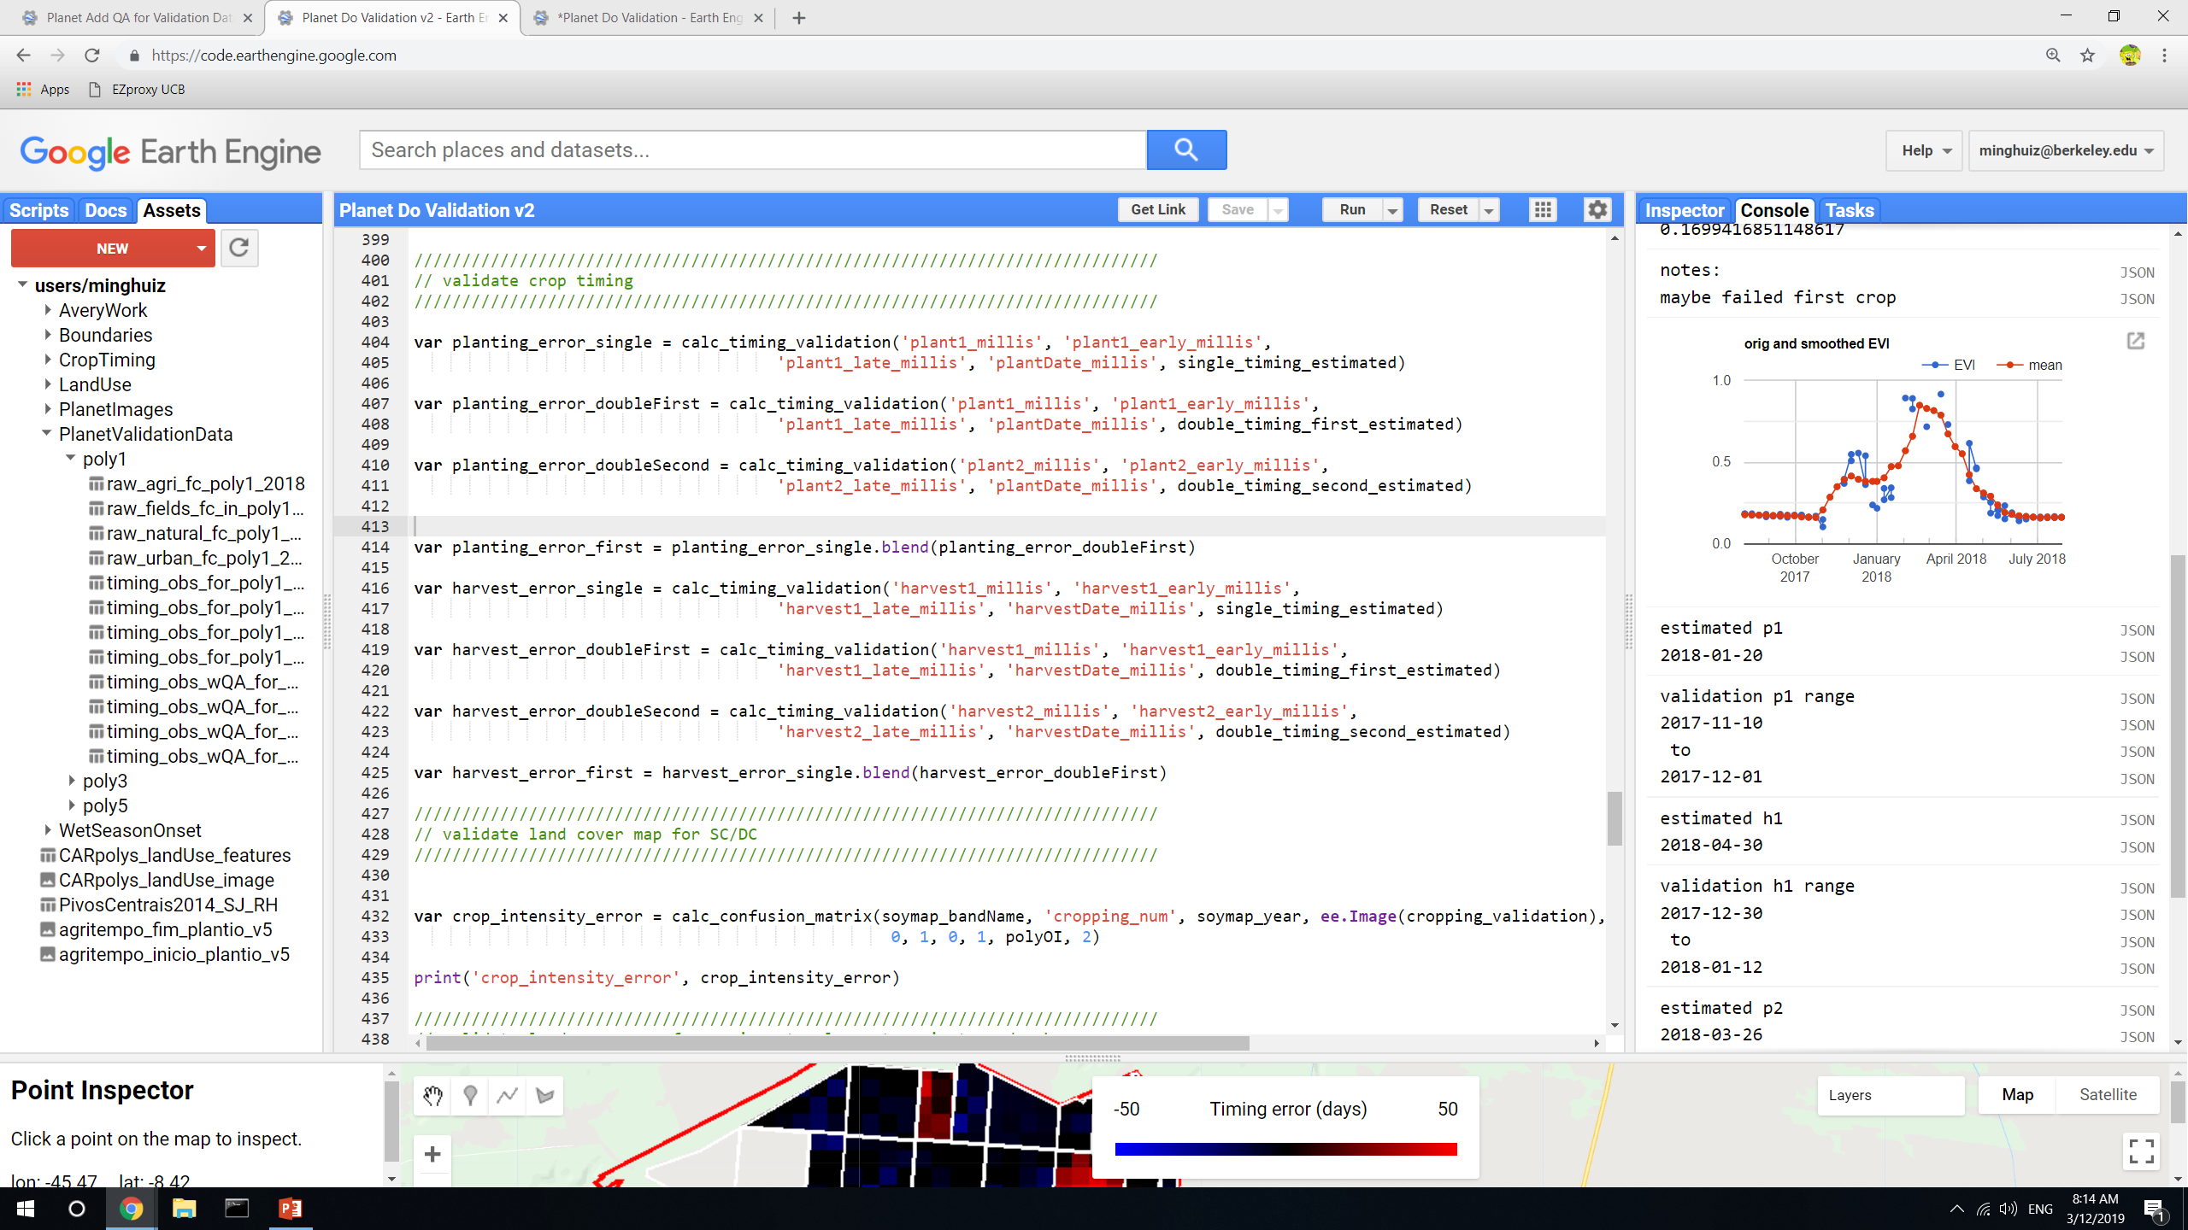
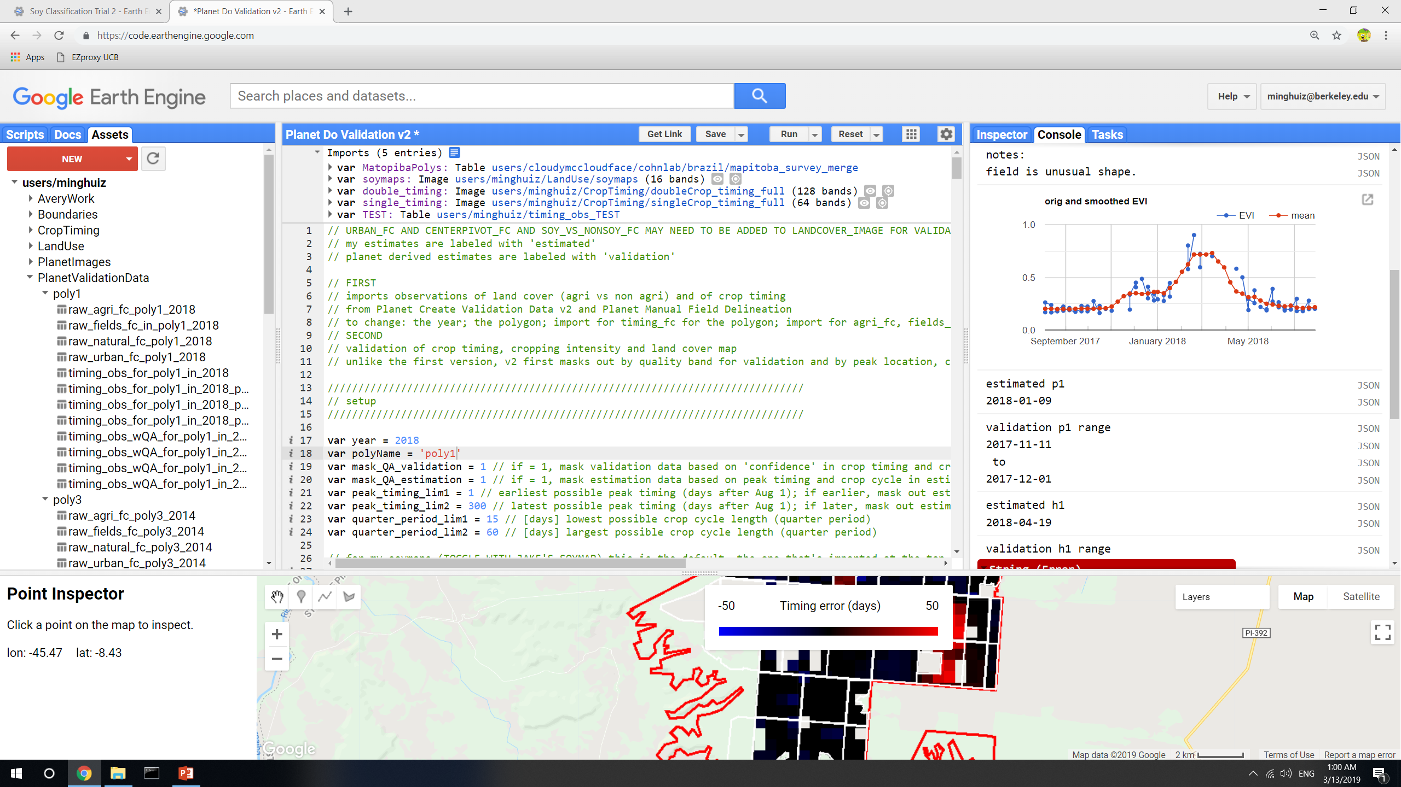
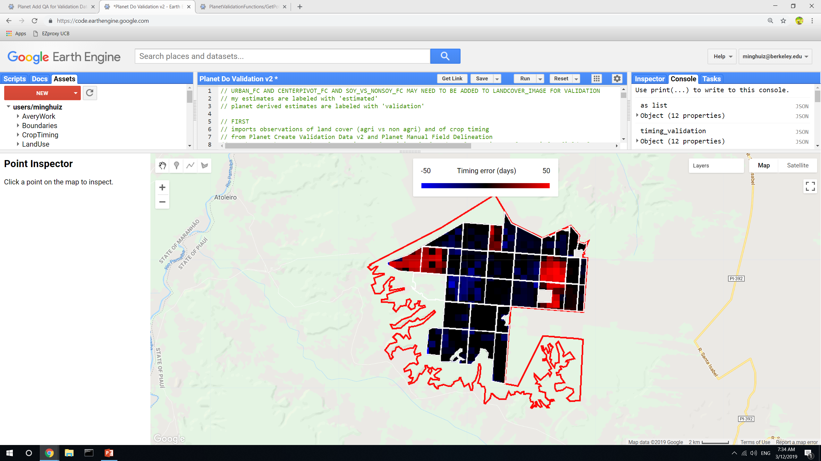
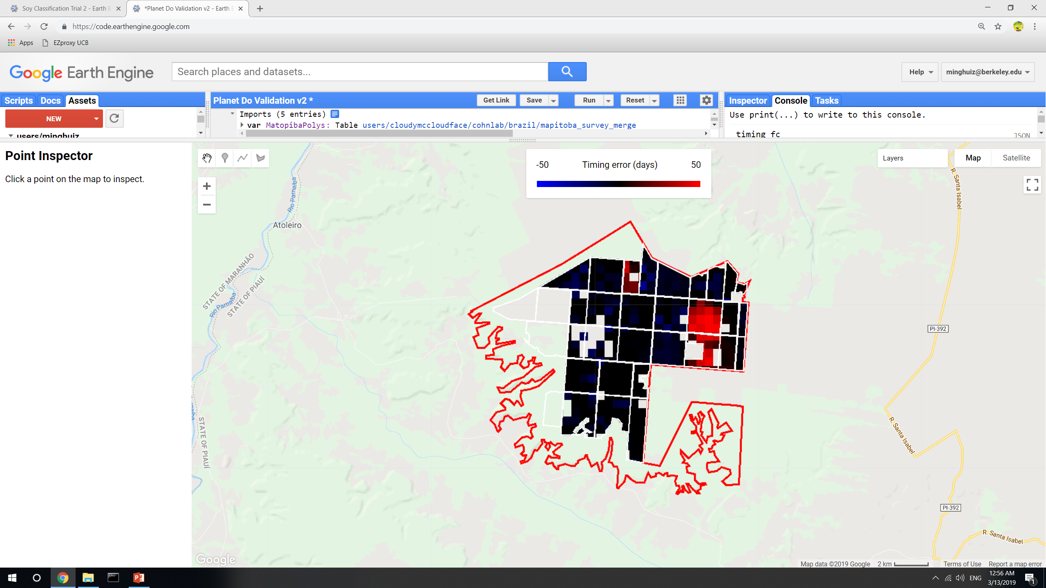
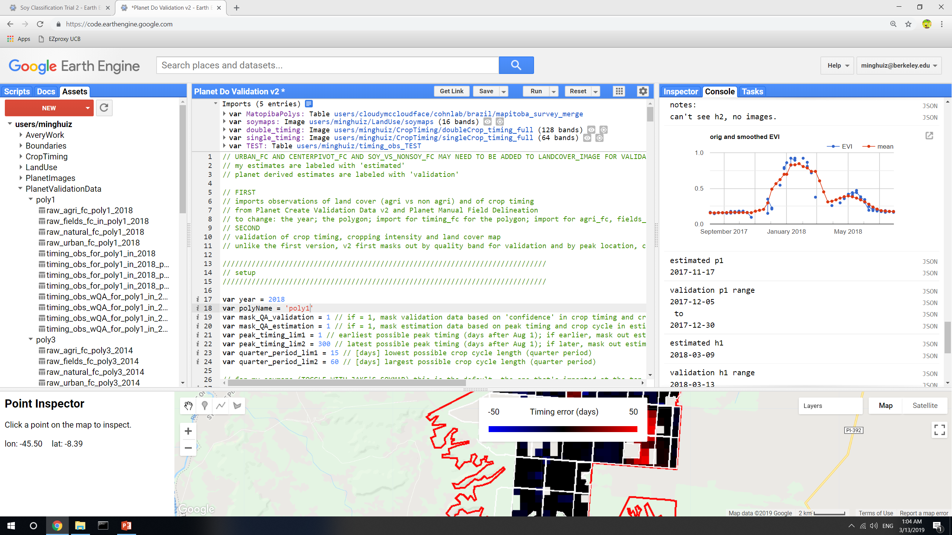
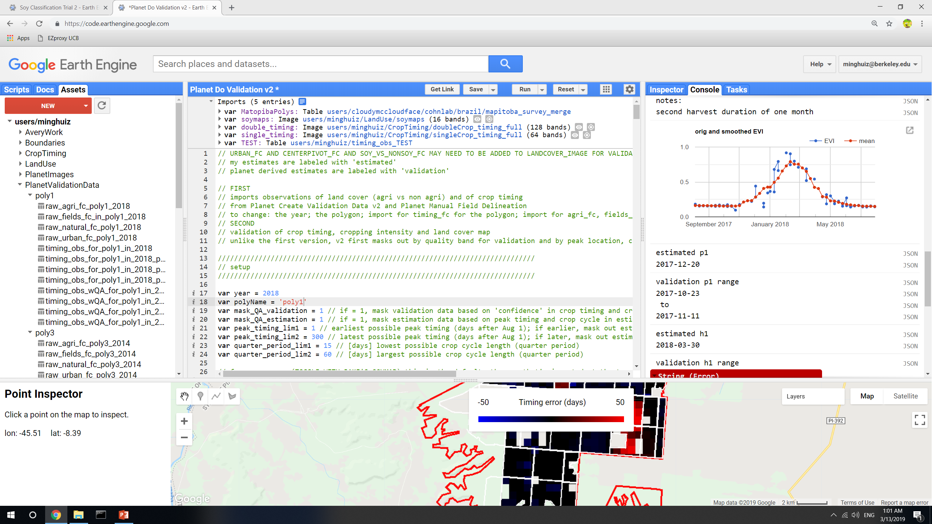
Poly1, 2018 before QA masking
Poly1, 2018, plant 1 after QA masking (of both pixel level estimates and entire fields based on validation data confidence)
Planting estimate mistook the second peak for the first peak
Planting estimate was probably better than validation data
GEE file: LandCover/Planet Do Validation v2

Slide 4
New soymaps (using additional training points beyond Jake’s method)
Pooling all years to train a single classifier
Adding PLOS training points
Notes
Soymap 2 does slightly better at classification than soymap 1 and Jake’s map
Accuracy in Matopiba is still low
 | Jake’s soymap | Soymap 1 | Soymap 2
GEE asset name | users/cloudymccloudface/cohnlab/agroserv/soy_sc_dc_agsat_mod_ls | Base_soymap_agsat_(year) for individual years soymap for image collection of all years | Base_soymap_agsat_PLOS_(year) for individual years Soymap_2 for image collection of all years
Training points | Soy_pts_agsat_1 (MT only) | Soy_pts_agsat_1 (MT only), masked with map3 agri | Soy_pts_agsat_1 (MT only), masked with map3 agri PLUS PLOS pts (MT only)
Year pooling | Each year has separate trained classifier | 2004-2017 points are pooled and are applied to 2004 – 2018; 2003 is trained and applied by itself | 2004-2017 points are pooled and are applied to 2004 – 2018; 2003 doesn’t have data yet
Input data | MODIS, Landsat | Same as Jake’s soymap | Same as Jake’s soymap MINUS Landsat bands

Slide 5
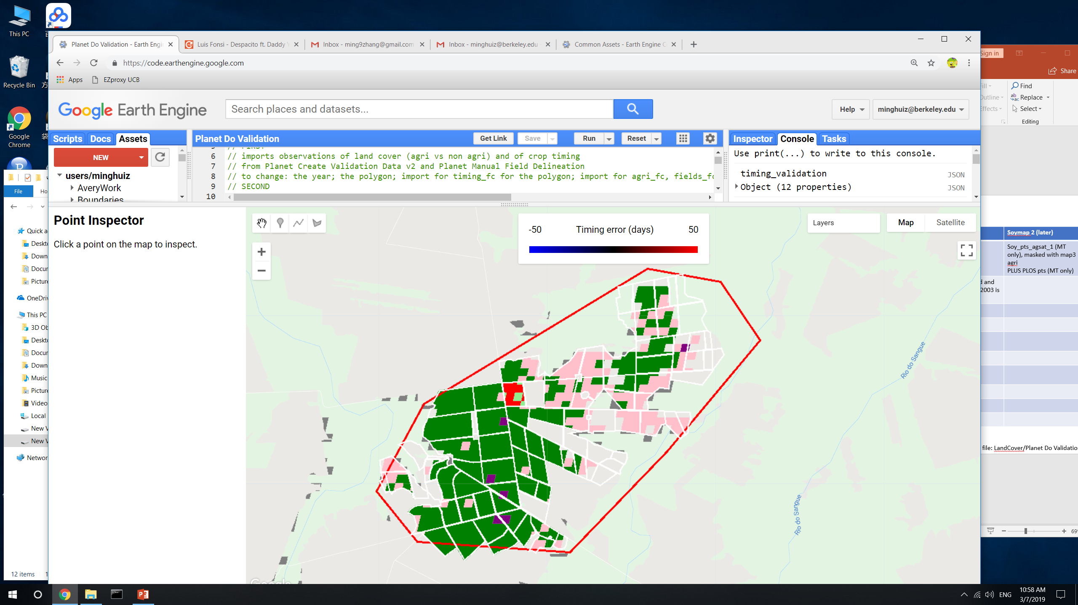
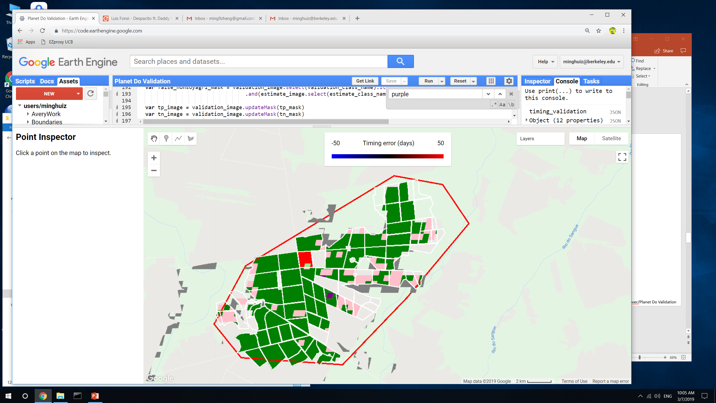
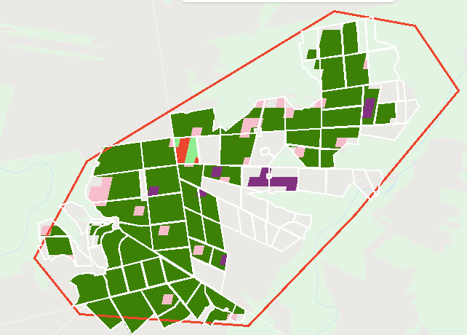
Land classification accuracy for poly5 (MT)
Legend:
True SC = light green
True DC = green
False SC = pink
False DC = red
False nonsoy agri = purple
False agri (actually natural) = gray
 |  | Jake’s soymap | Soymap 1 | Soymap 2
Poly5 (MT) | True SC | 0.01 | 0.005 | 0.015
 | True DC | 0.78 | 0.86 | 0.9
 | False SC | 0.18 | 0.11 | 0.07
 | False DC | 0.02 | 0.03 | 0.02
Jake’s soymap
Soymap 1
Soymap 2
GEE file: LandCover/Planet Do Validation v2

Slide 6
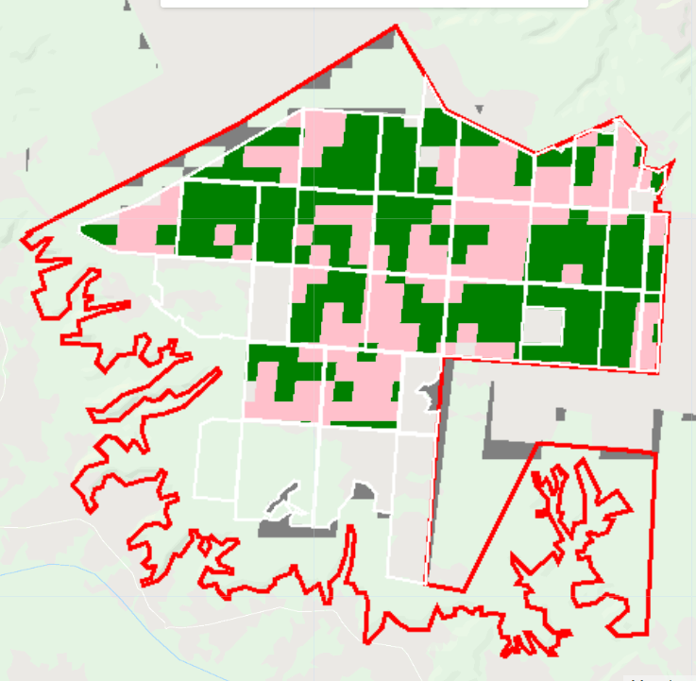
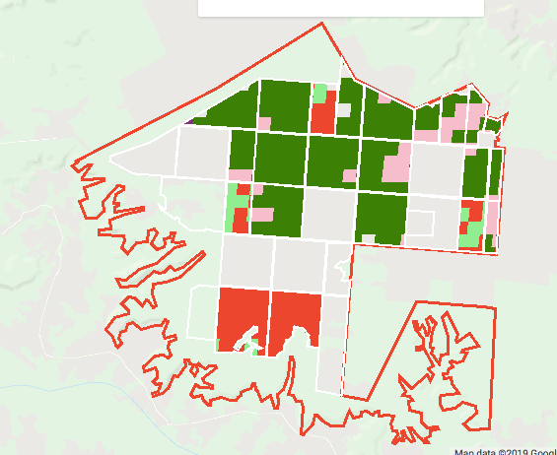
Land classification accuracy for poly1 (Piaui)
Legend:
True SC = light green
True DC = green
False SC = pink
False DC = red
False nonsoy agri = purple
False agri (actually natural) = gray
 |  | Jake’s soymap | Soymap 1 | Soymap 2 (later)
Poly1 (Piaui) | True SC | n/a | 0.12 | 0.07
 | True DC | n/a | 0.37 | 0.59
 | False SC | n/a | 0.33 | 0.10
 | False DC | n/a | 0.17 | 0.22
Soymap 1
Soymap 2
In soymap2, fields are more likely to be lumped in the same class, which is encouraging (soymap2 is more ‘stable’ within each field). This stability could be due to more training points or because Landsat introduced unnecessary and confusing timeseries information
GEE file: LandCover/Planet Do Validation v2

Slide 7
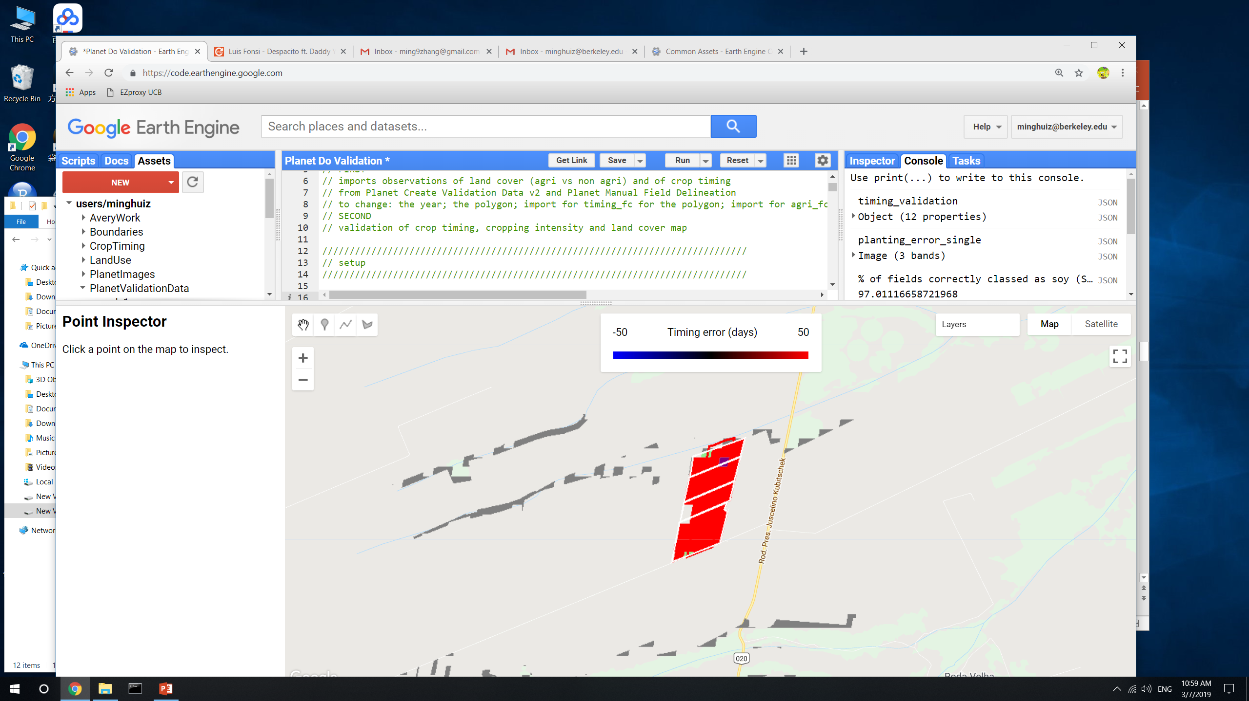
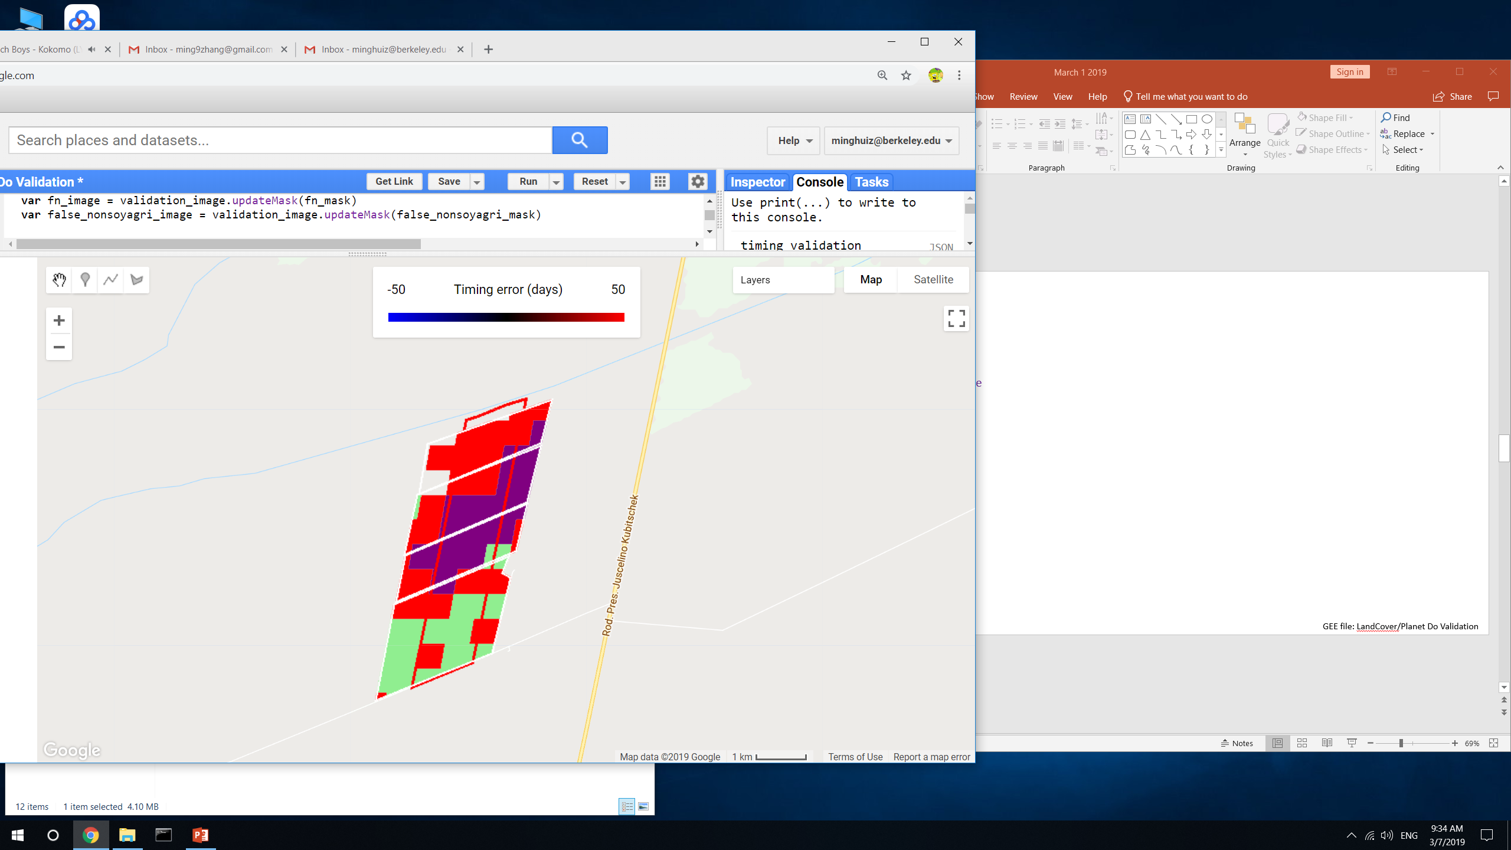
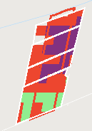
Land classification accuracy for poly3 (Bahia)
Legend:
True SC = light green
True DC = green
False SC = pink
False DC = red
False nonsoy agri = purple
False agri (actually natural) = gray
 |  | Jake’s soymap | Soymap 1 | Soymap 2 (later)
Poly3 (Bahia) | True SC | 0.03 | 0.38 | 0.27
 | True DC | 0 | 0 | 0
 | False SC | 0 | 0 | 0
 | False DC | 0.97 | 0.63 | 0.74
Jake’s soymap
Soymap 1
Soymap 2
GEE file: LandCover/Planet Do Validation v2

Slide 8
Spectral separation of Soy vs Nonsoy Agri
For agsat and PLOS training points, look at individual MODIS bands (which are used as input data for classification), aggregated over months, for each of the three classes (SC soy, DC soy, nonsoy agri)
Analysis was based on (Wilson et al, 2014)
Two ways to pick the dates over which to differentiate crops:
By days after planting
By data acquisition date (i.e. July 10, July 20, etc)
Found that late vegetative growth stage is optimal for crop separability (early vegetative stage: plants are too small and soil patches interfere)
Notes:
Mainly want to figure out how to separate nonsoy agri from the other two classes because can use timeseries analysis to separate SC from DC
MODIS band number | Wavelength (nm) | Name
1 | 620 - 670 | red
2 | 841 - 876 | nir
3 | 459 - 479 | blue
4 | 545 - 565 | green
5 | 1230 – 1250
6 | 1628 - 1652 | (not in the plots below)
7 | 2105 - 2155

Slide 9
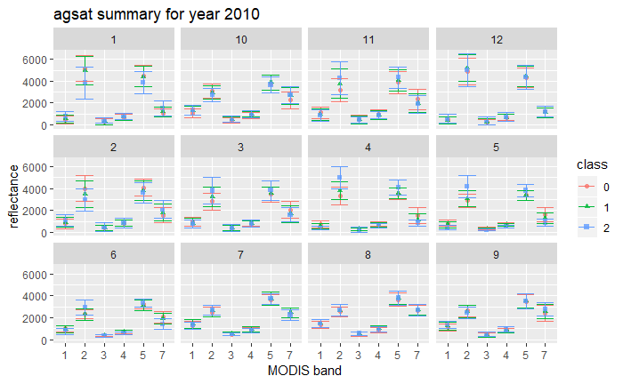
Panels = months
Class 2 = nonsoy agri
Class 0 and 1 = soy, SC and DC
R N B G
R file: Spectral_differentiation_v2.Rmd

Slide 10
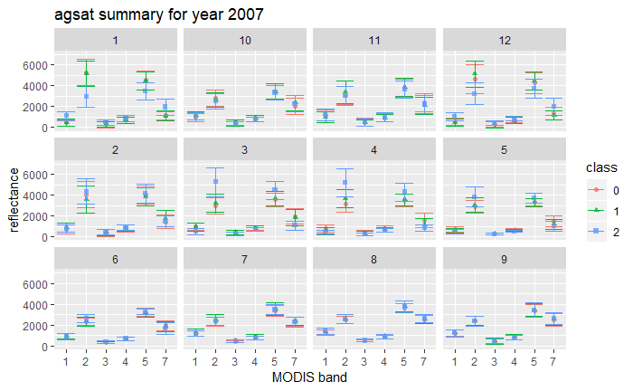
R file: Spectral_differentiation_v2.Rmd

Slide 11
Takeaways for spectral differentiation
Band 2 (NIR) is lower for class = 2 in Dec, Jan and Feb; it’s higher for class = 2 in March, April, May June
Band 5 is lower for class = 2 in Dec, Jan and Feb; it’s higher for class = 2 in March, Apr, May
There’s pretty much nothing in July, Aug, Sept, and Oct that can separate the three classes
Band 7 has larger scatter for class = 2 than for other cases, so band 7 is probably the least useful overall.
Band 1 (red) is higher for class = 2 in Dec and Jan; sometimes lower for class = 2 in July and Aug
For class = 2, there’s less vegetation (lower NIR, higher red) in Dec – Feb and more vegetation (higher NIR, lower red) in March – Aug

Slide 12
Temporal/phenological separation of Soy vs Nonsoy Agri
Temporal PCA on agsat and plos points for MODIS-derived EVI
‘variables’ are mean EVI in each 10-day chunk (i.e. 37 columns = 0 to 10 days, 11 to 20 days… after Jan 1)
‘rows/observations’ are the data points (i.e. spatial variability)
Examine what times of year have greatest contribution to spatial variability in EVI
EVI timeseries for each land cover class
2007 | Agsat | Plos
Class 0 (SC) | 15410 | 8567
Class 1 (DC) | 71581 | 10537
Class 2 (nonsoy agri) | 3636 | 9046
For interpreting results:
Agsat has more points, but Plos has more even distribution among classes
Plos lumps pasture into nonsoy agri, whereas agsat probably doesn’t

Slide 13
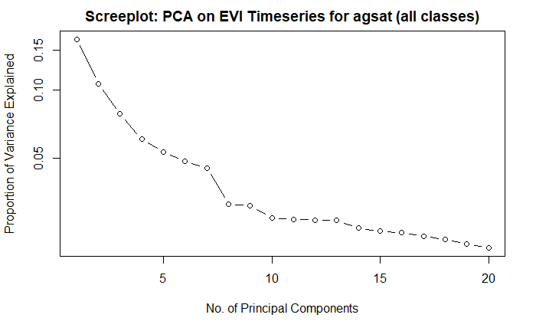
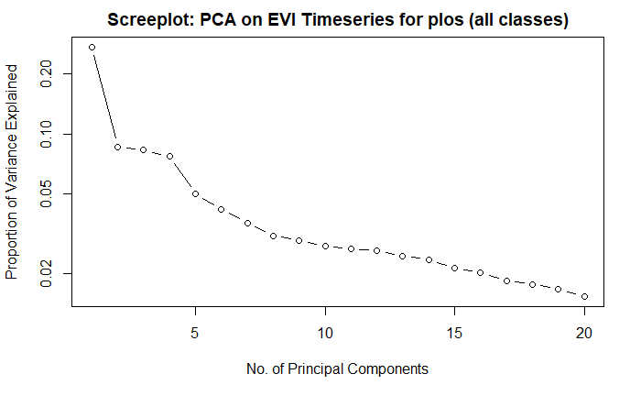
Spatial PCA on agsat and plos training data points in Mato Grosso
Year = 2007
The first several principal components don’t capture more than 50% of variation
In the loadings graphs below, positive correlation means the DOY contains a spatial pattern that has strong similarity to the pattern in the component image (i.e. that DOY reflects difference across space and therefore could be used in separating the classes?)
R file: Temporal_differentiation.Rmd

Slide 14
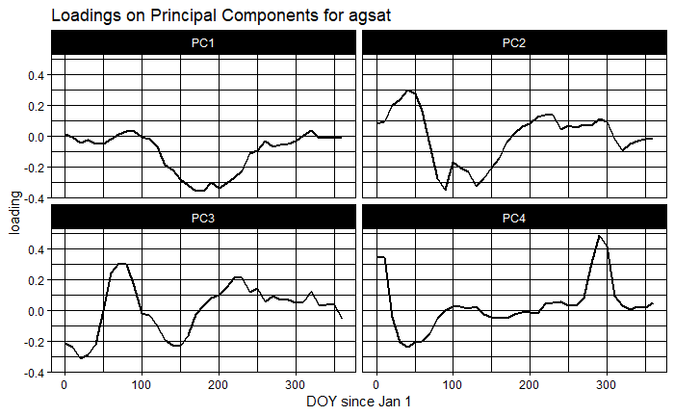
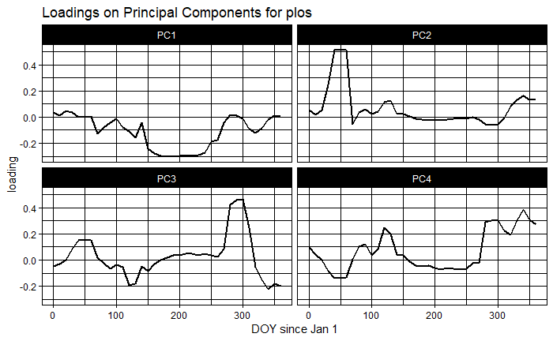
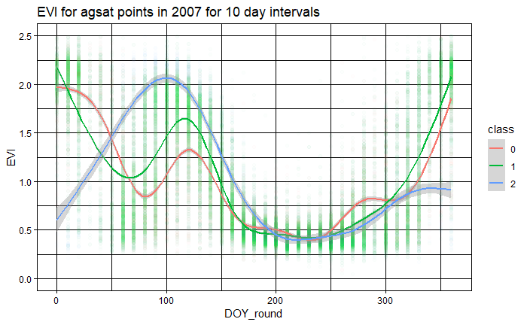
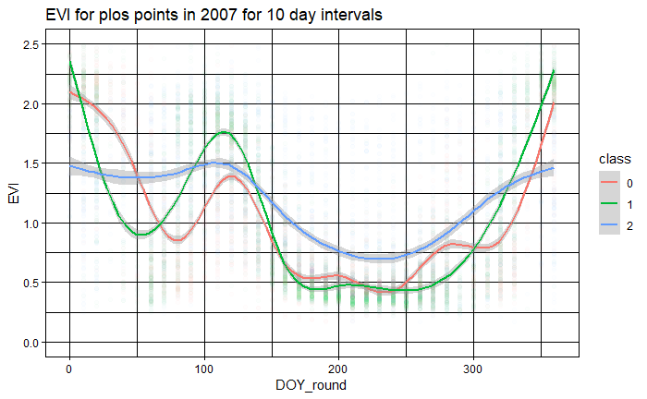
Spatial PCA on agsat and plos training data points in Mato Grosso
Year = 2007
R file: Temporal_differentiation_PCA.Rmd and Temporal_differentiation_timeseries.Rmd

Slide 15
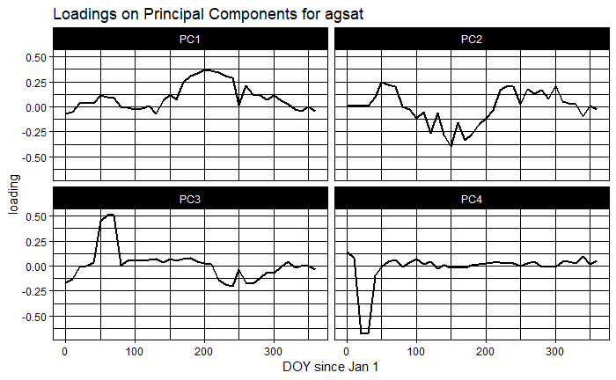
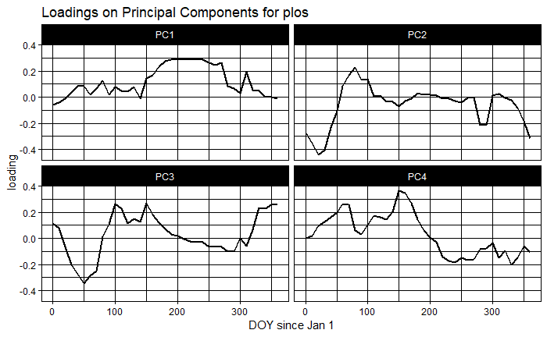
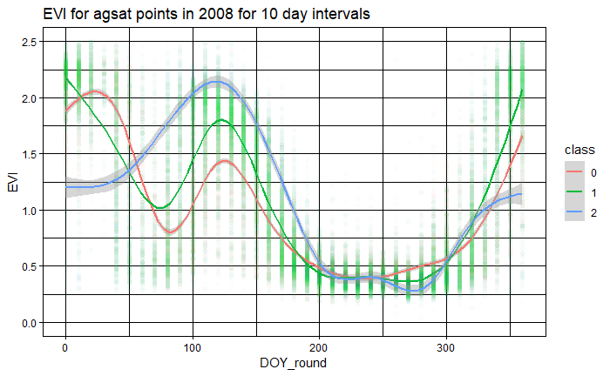
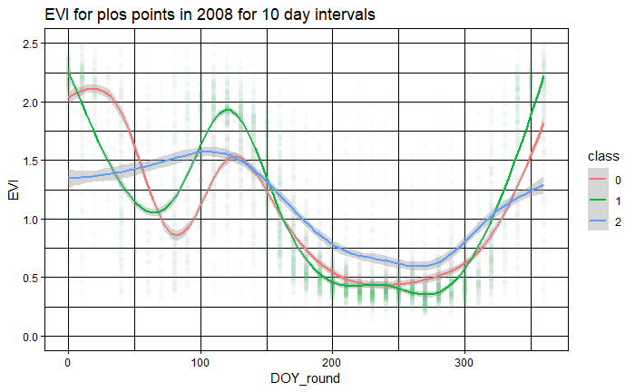
Spatial PCA on agsat and plos training data points in Mato Grosso
Year = 2008
R file: Temporal_differentiation_PCA.Rmd and Temporal_differentiation_timeseries.Rmd

Slide 16
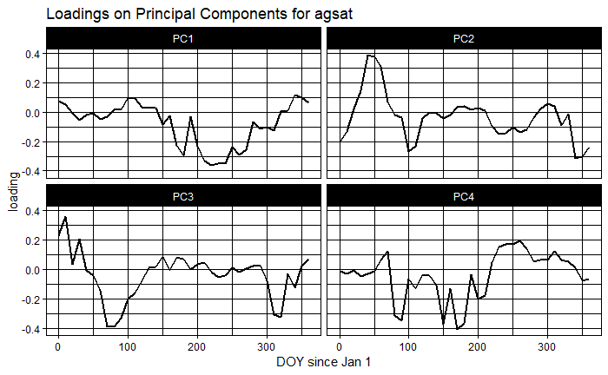
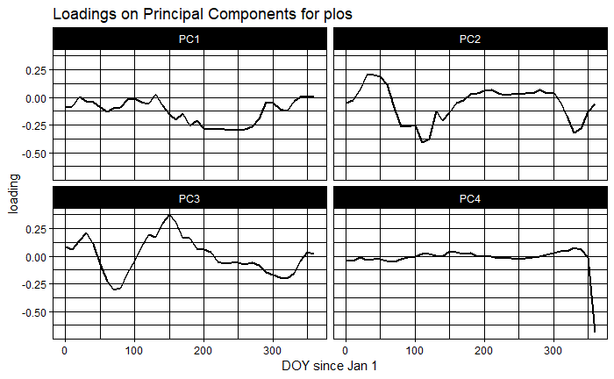
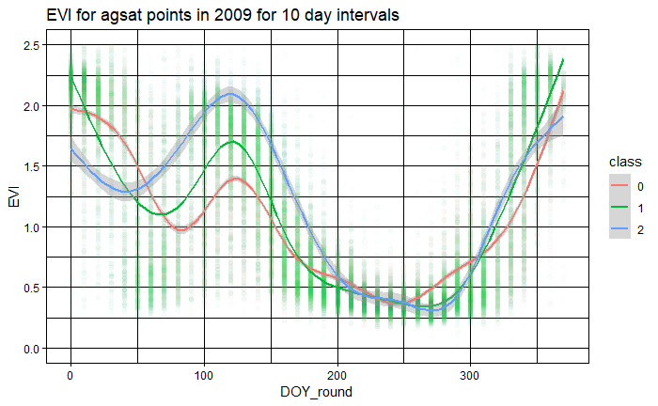
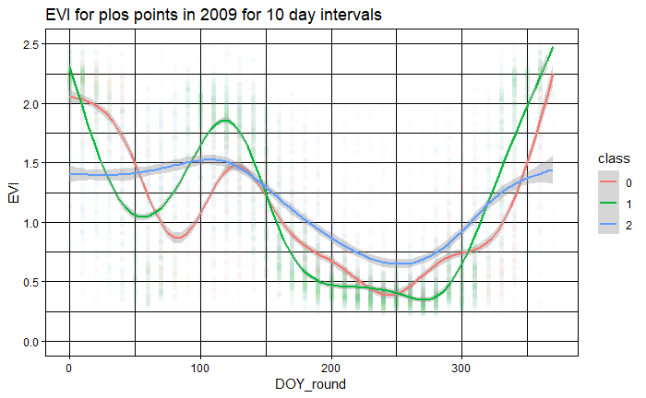
Spatial PCA on agsat and plos training data points in Mato Grosso
Year = 2009
R file: Temporal_differentiation_PCA.Rmd and Temporal_differentiation_timeseries.Rmd

Slide 17
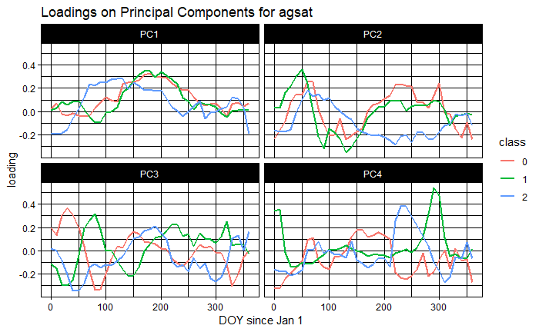
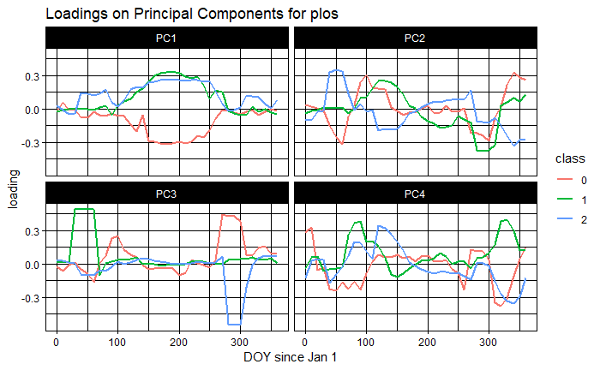
Spatial PCA on agsat and plos training data points in Mato Grosso
Year = 2007
It doesn’t make sense to do separate PCAs for each class, because all the within-class PCAs will show is how to separate WITHIN each class
The fact that the within-class PCAs have nonzero loadings suggests that there’s a lot of variation within each class?
R file: Temporal_differentiation.Rmd

Slide 18
Takeaways for phenological differentiation
From PCA
A PCA that lumps all classes together shows variation between the classes, but also variation within the classes.
Because plos has a more even distribution among the classes, it’s probably more reliable.
However, plos’s class = 2 contains pasture, which would be masked out with mapbiomas3 agri.
The variables DOY = 100 to 250 (April to August) tend to be more correlated with PC1. The variables DOY = 0 to 100 (January to March) tend to be more correlated with PC2.
PC1 seems to pick up on seasonal patterns; PC2 seems to pick up on the significant inter-class differences that happen between DOY = 0 and 150
Overall, can’t interpret much from PCA (ask Iryna?)
From timeseries
The first 150 days of the year (January to May) best separate the three classes
On average between DOY = 50 to 150, class = 2 has higher EVI than the other classes
On average between DOY = 0 to 50, class = 2 has lower EVI than the other classes
DOY 200 to 300 (July to October) don’t help separate the classes at all
PLOS contains pasture, so its class = 2 timeseries looks very different from the other two classes in the dry season (it’s much higher); however, in agsat, class = 2 looks very much like the other classes during the dry season
This analysis might help in picking the best time to separate classes, but doesn’t help in creating training data…

Slide 19
Based on spectral and phenological differences, target mid to late vegetative stage of first crop and the whole second crop; avoid dry season
Proposed input data for separating the three classes
From spectral differences (mid to late vegetative stage)
NIR from Dec to June
B5 from Dec to June
B1 from Dec to Jan
B1 from July to Aug
From observations of timing estimates
Days between peak1 and peak2
Quarter period of crop1 and crop2
Days after Aug 1 of peak1
From phenological differences (mid vegetative stage; usually the time fields transition from first to second crop)
EVI from January to March (NOT July to October)
Mato Grosso -> Matopiba
To apply classifier trained in Mato Grosso to Matopiba, doing data acquisition date alone won’t work because seasonality and planting dates are different
Option 1: get training data for Matopiba (soy vs nonsoy – how to get?)
Option 2: use classifier that was trained in Mato Grosso but adjust the data acquisition date
Shift data acquisition dates 1 - 2 months later based on lag in wet season onset in Matopiba compared to Mato Grosso
Come up with some way to figure out average mid-late vegetative stage of crops in Matopiba

Slide 20
Next
Ask Iryna about spectral and temporal separation of soy from nonsoy agri (purpose is to create training data in Matopiba)
Purchase Planet imagery + analyze
Create SC/DC training data in Matopiba with the help of Planet imagery; create soy vs nonsoy training data in Matopiba if possible
Soymap classification with the new input data from timing estimation, phenological + spectral differentiation results, new Matopiba training data if available
Center pivot

